Slide 1

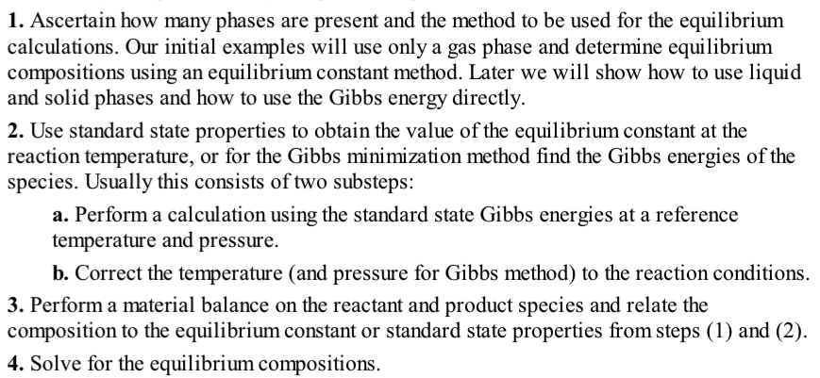
In Chapter 3 we were given the extent of reaction, ξ.
In Chapter 17 we determine the equilibrium extent of reaction.

Slide 2
Rate Constant vs. Equilibrium Constant
Reaction rate constant k
How fast will the reaction proceed?
Activation Energy E_{a} for the reaction.
Arrhenius (1890’s) (Forced global
warming predicted 1896)
Eyring, Polanyi, Evans Rate Theory
Gasoline in a gas tank does not explode due to kinetic limitations.
Gasoline is reactive but kinetically stable
Reaction equilibrium constant K_{a}
Is the reaction possible?
Endergonic, Exergonic
Endothermic, Exothermic
What are the equilibrium concentrations?
Gibbs free energy change in the reaction.
Gasoline in an engine can ideally produce
46.4 MJ/kg at equilibrium (Li-ion battery 0.46 MJ/kg)
(engine ~50% efficiency vs. motor ~100% efficiency).
Gasoline is not thermodynamically stable.
K_{a}

Slide 3
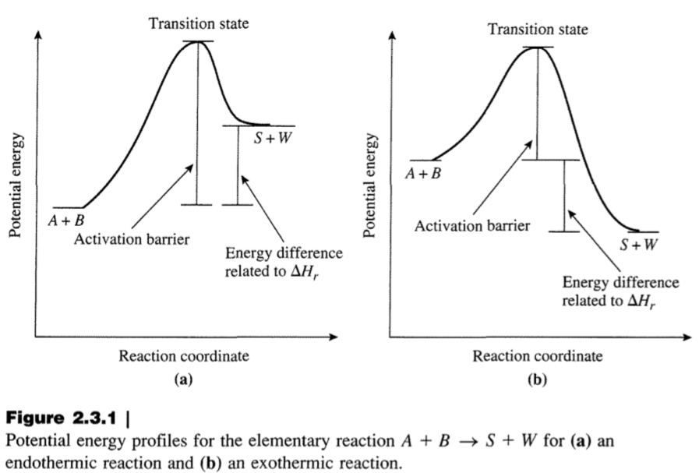

Slide 4
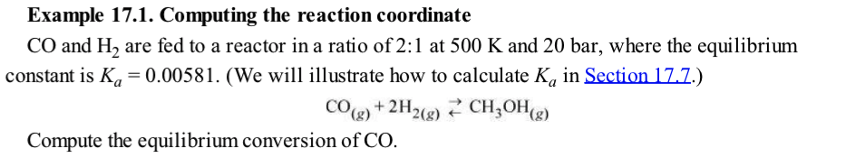

Slide 5
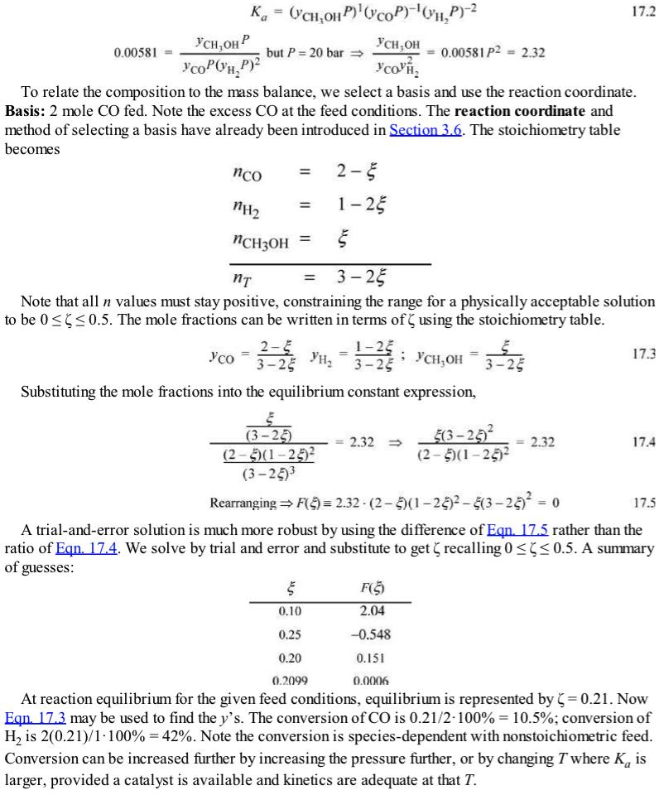

K_{a} has units of (bar)⁻²
Feed is 2 CO: 1 H₂
0 ≤ ξ ≤ 0.5

Slide 6
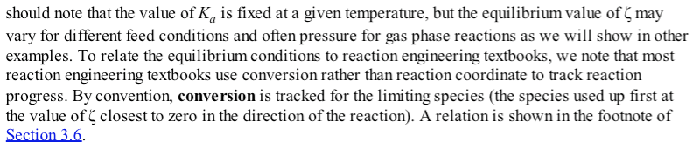

Slide 7
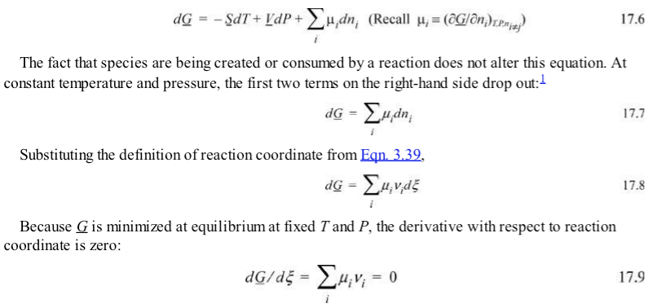
Extrinsic

Slide 8



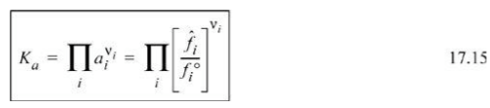


Slide 9
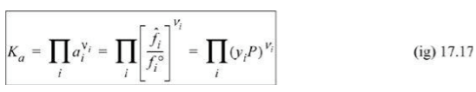




Slide 10
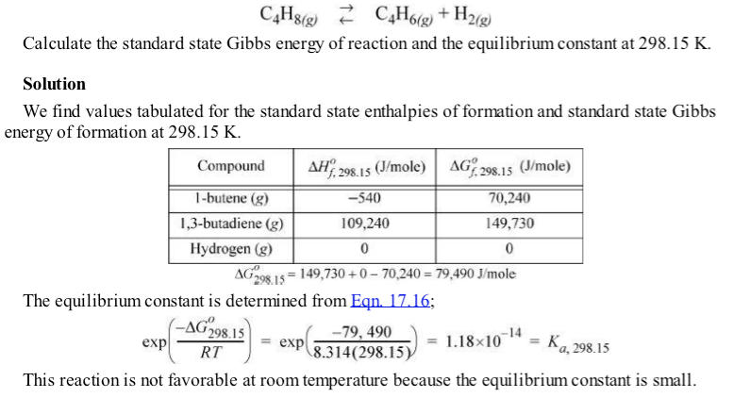

Slide 11


Slide 12
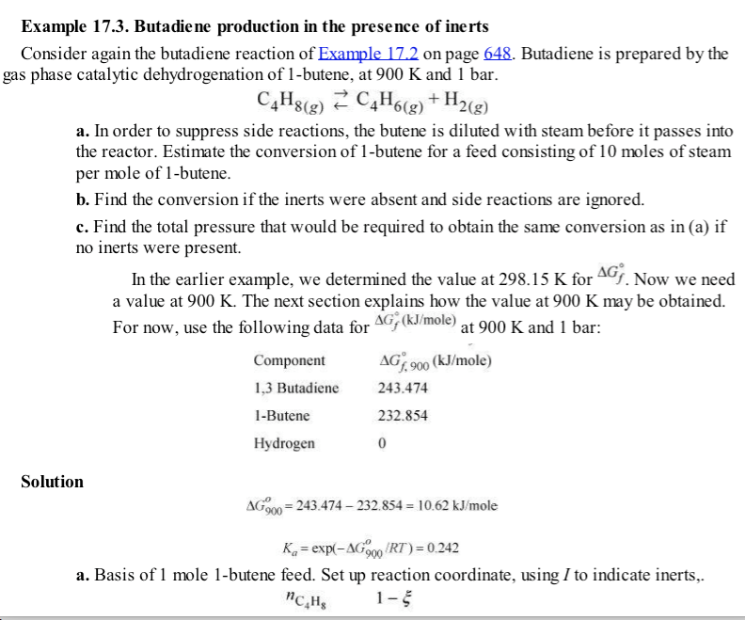

Slide 13
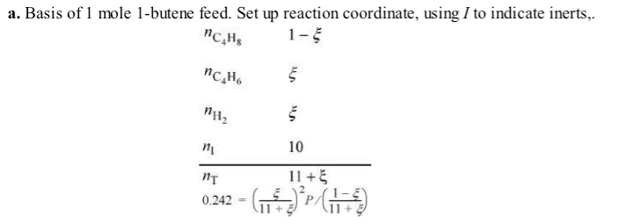
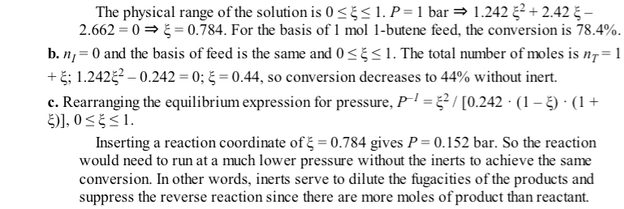

Slide 14
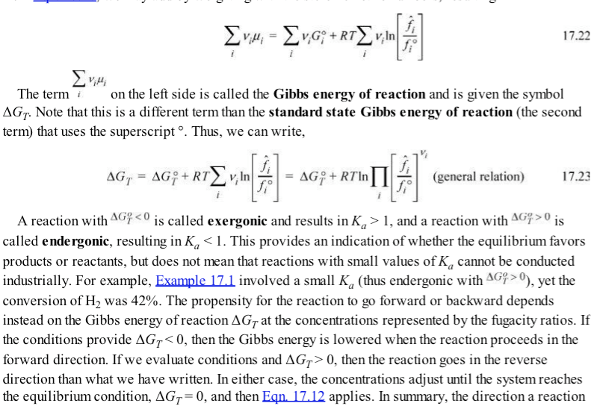

Slide 15
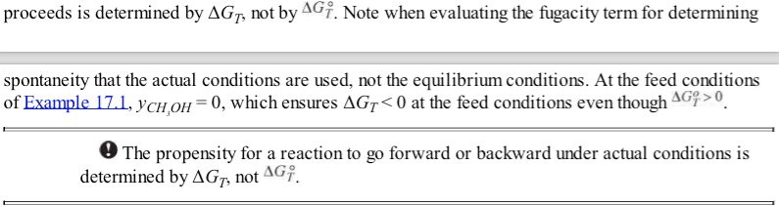

Slide 16
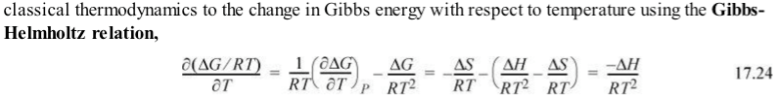
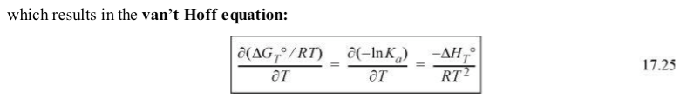


Slide 17
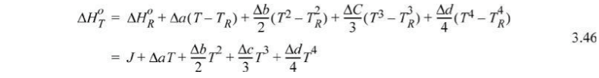
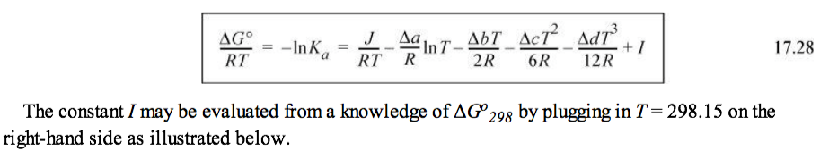
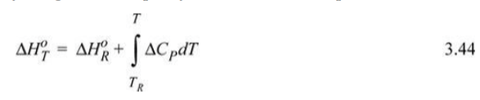
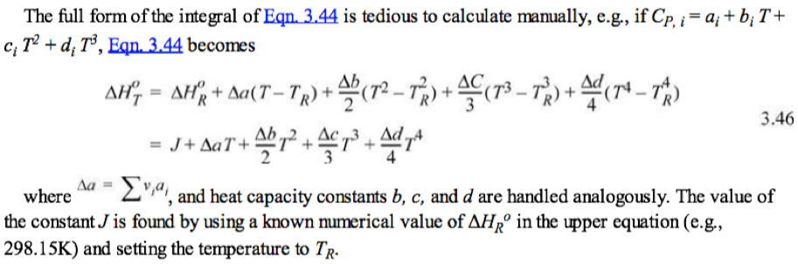
Standard heat of reaction
Standard heat of reaction

Slide 18
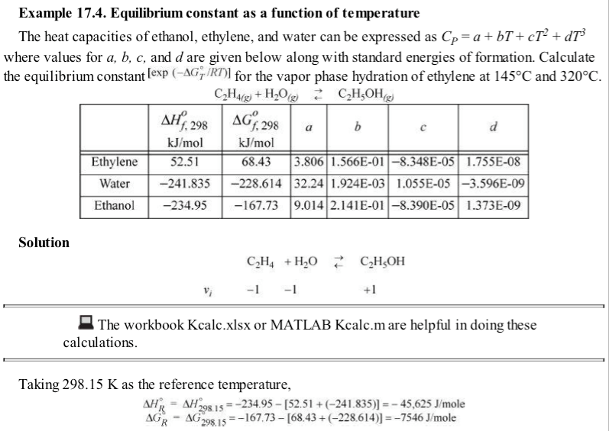
-7.5

Slide 19
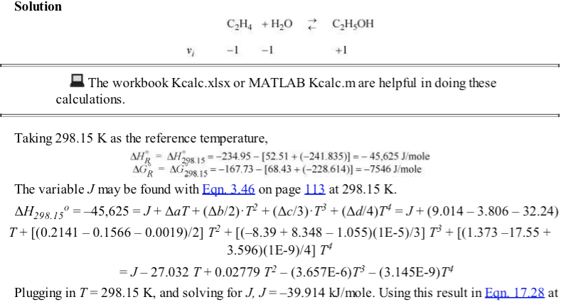
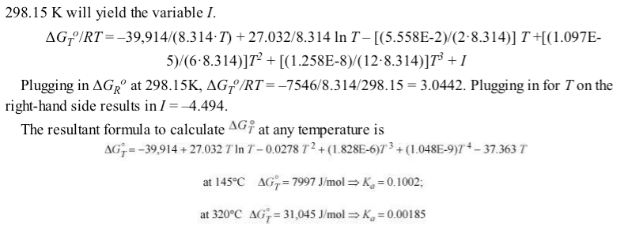

Slide 20
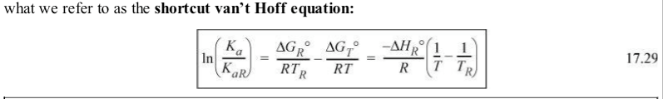
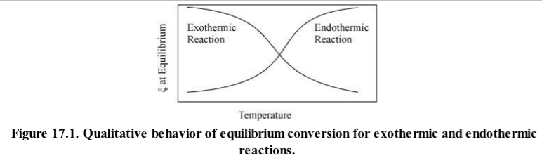
Assume all species same
size and all gas or liq.
Assume ΔC_{p} = 0
So J =ΔH_{R}⁰

Slide 21

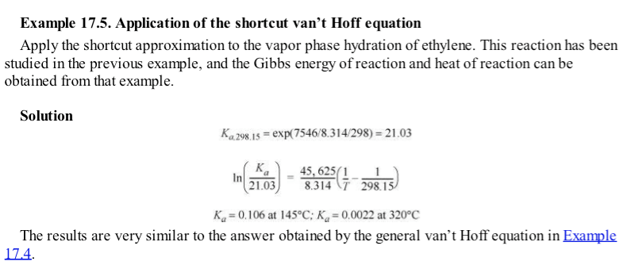

Example 17.4

Slide 22
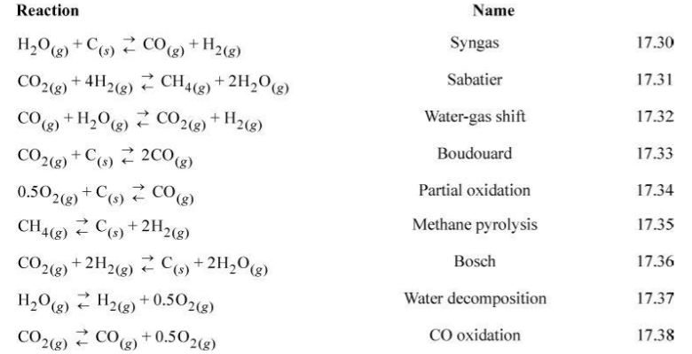

Slide 23
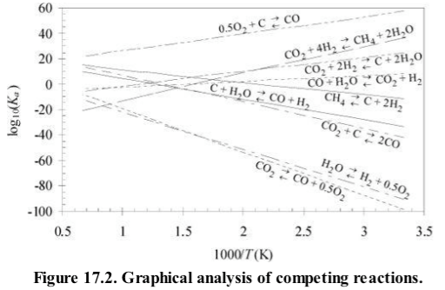

Slide 24
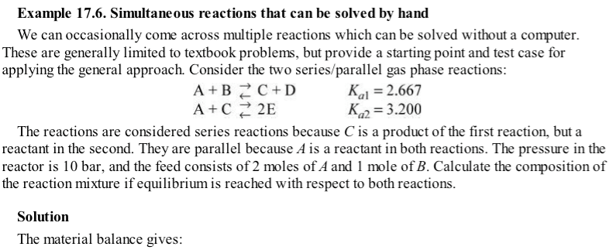

Series Reactions &
Parallel Reactions

Slide 25
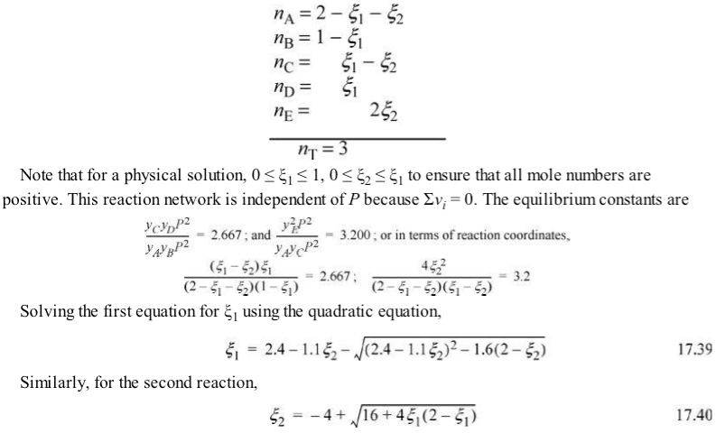

Slide 26
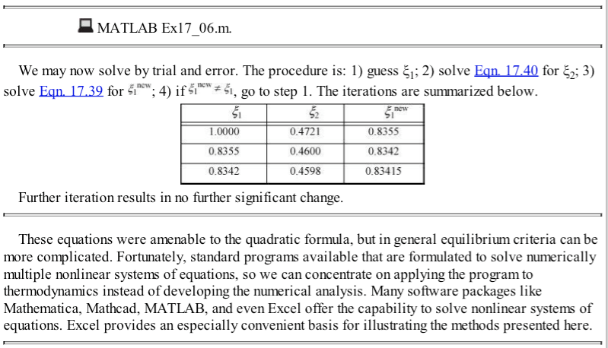
Example 17.6 excel

Slide 27

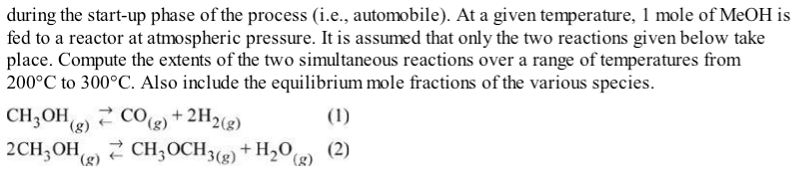

Slide 28
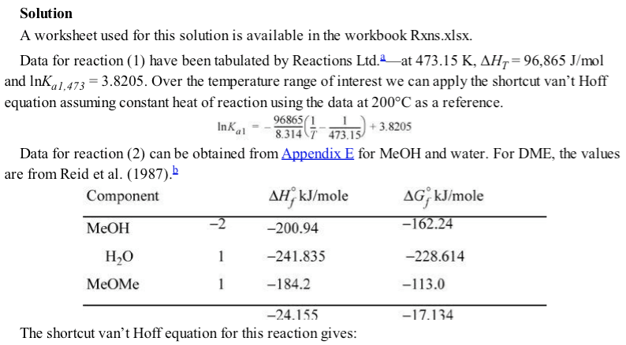



Slide 29
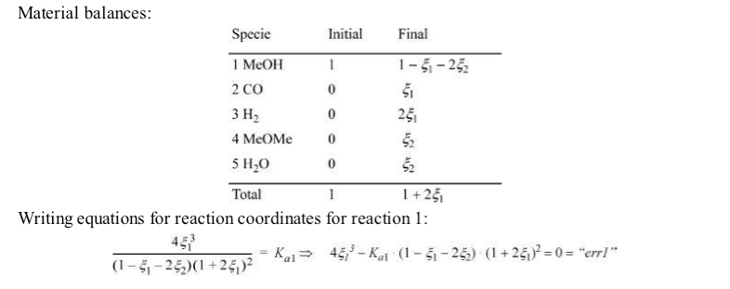
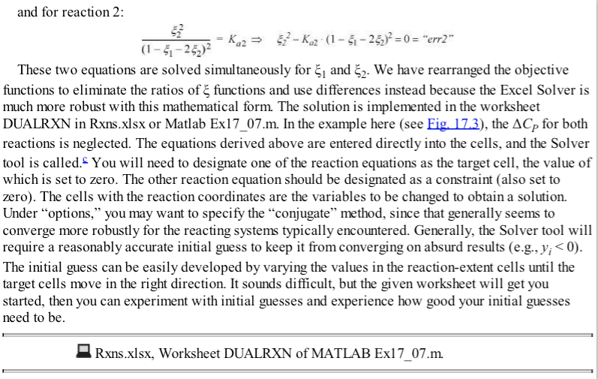
P²
P²

Slide 30
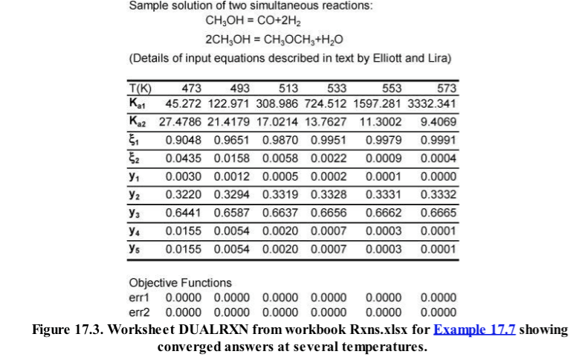

Slide 31


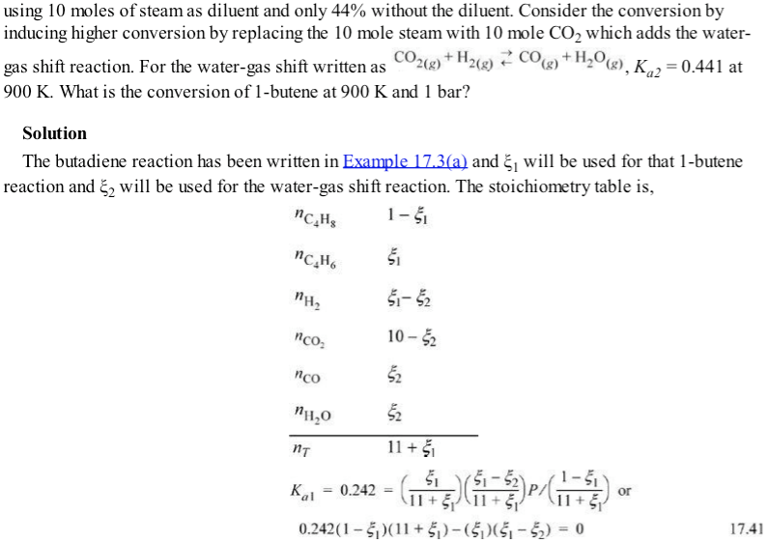

Slide 32
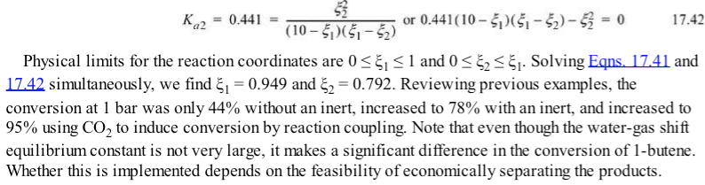

Slide 33
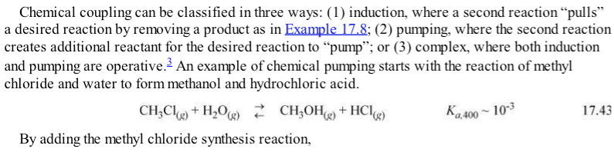
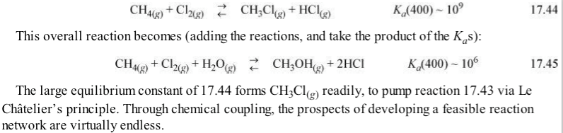
Induction = Pulls product
Pumping = Create reactant
Complex does both

Slide 34
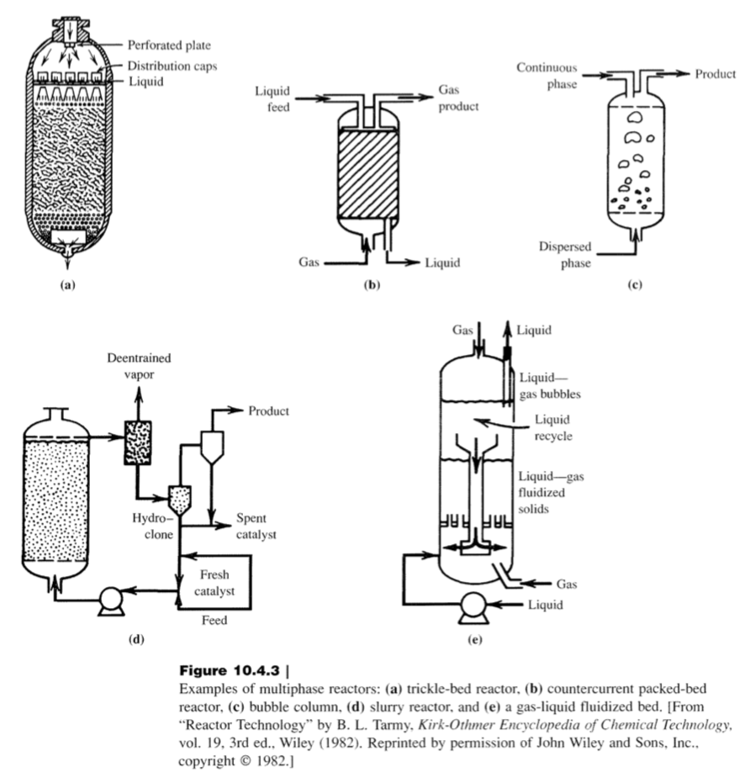
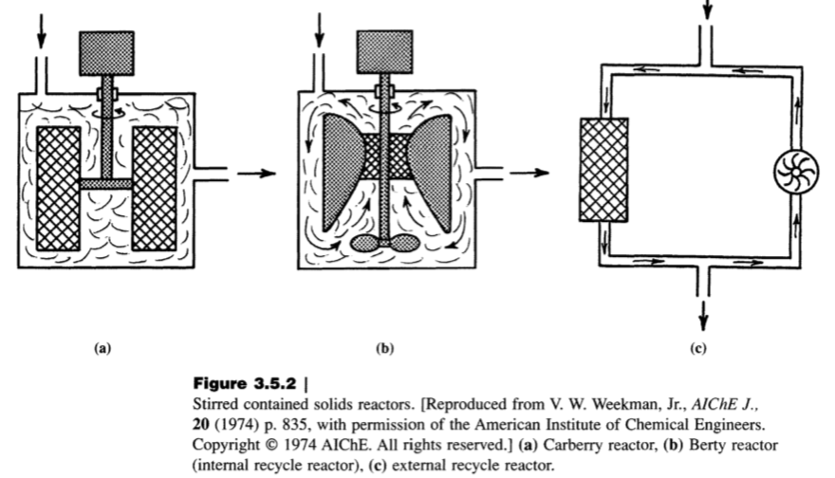
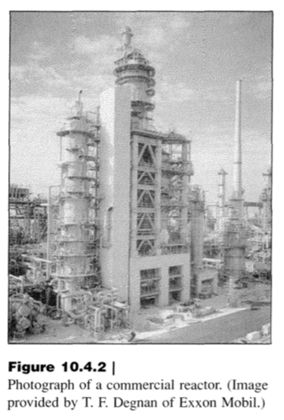
Flow reactors can be transport limited (all reactants react when they get to the reaction site so the rate is controlled by diffusion and convection)
Or reaction limited, transport doesn’t matter since when the reactants get to the reaction site only a fraction of them react.

Slide 35

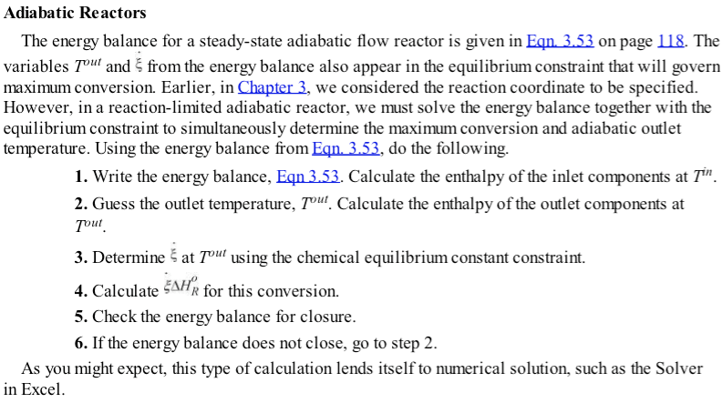
Reactors can be

Slide 36
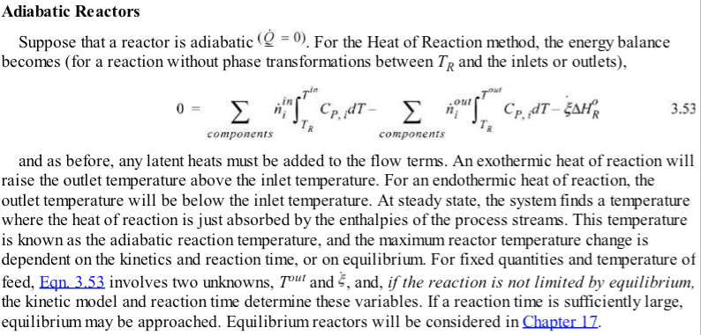
Section From Chapter 3

Slide 37
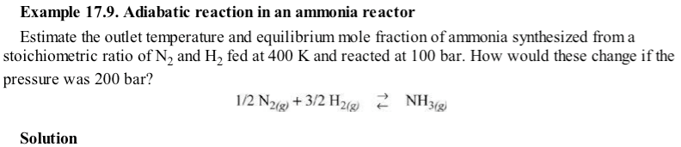
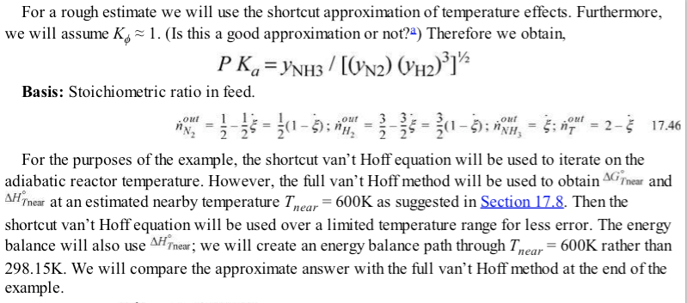

Slide 38
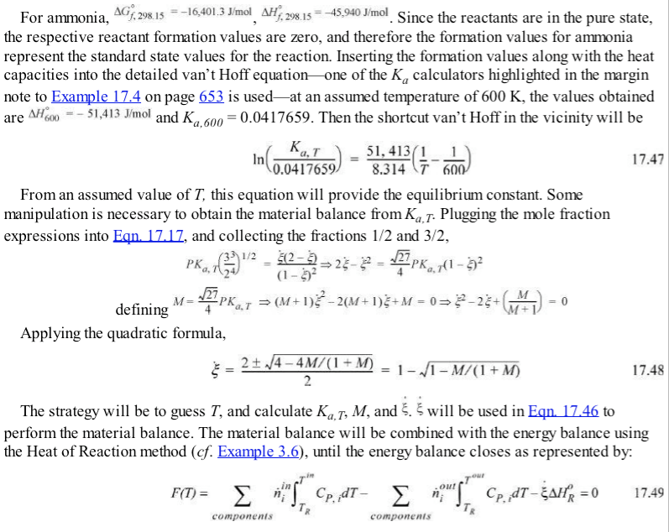
Kcalc.xls

Slide 39
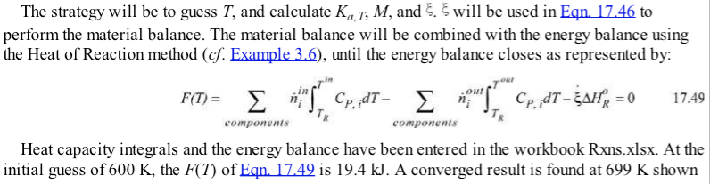
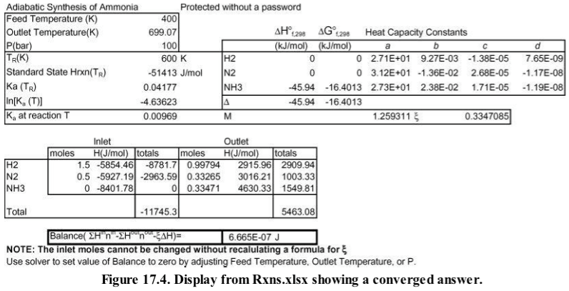

Slide 40


From K_{a}(T) and the reaction stoichiometry

Slide 41



Slide 42



Slide 43


Slide 44


Slide 45






Slide 46


Given the final pressure, you can calculate K_{a}

Slide 47
[A] = y_{A}(n/V) = y_{A} P/(RT)
Assumptions:
-This is for an elementary reaction where the reaction proceeds by random collision of species.
-There are no special complexes required for the reaction to proceed.
-No ionic or steric effects, no reaction complex.
-The elementary reaction model relies on the ideal gas law.

Slide 48



Slide 49


Slide 50


Slide 51



Slide 52



These are molar for pure
components, y_{i} = 1; n_{i} = 1

Slide 53

This requires Chapter 15 p. 587-601

Slide 54


Slide 55



Slide 56


Slide 57


Slide 58



Slide 59


Slide 60




Slide 61
17.7
17.22
Practice Problems 17.1, 17.4, 17.9
Test-yourself’s OK but short

